Slide 1
Ray tracer
--Neeraj surjaye

Slide 2
agenda
INTRODUCTION
VECTORS
RENDERING PROESS
THE CAMERA
THE SPHERE
RAY
RAY OBJECT INTERACTION
MATERIALS
ADDING EVERYTHING
CODE
END

Slide 3
VECTORS
-vectors

Slide 4
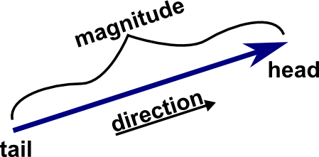
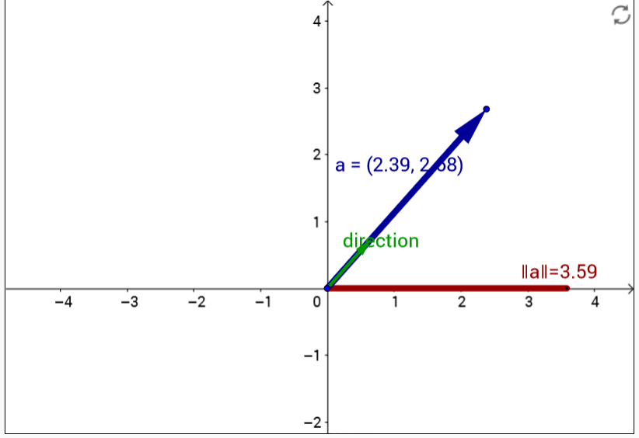
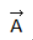
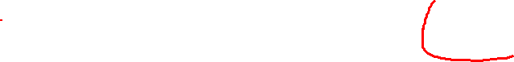
Vectors
Have both a magnitude and a direction.

Slide 5
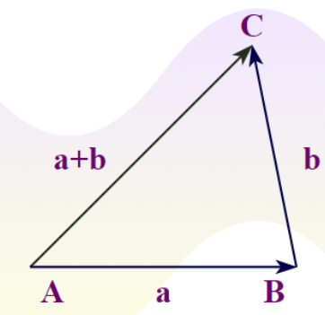
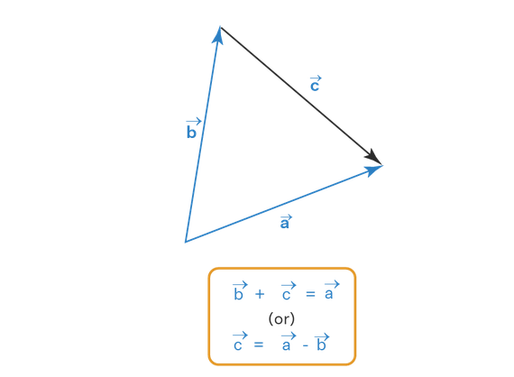
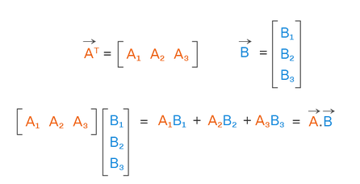
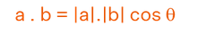
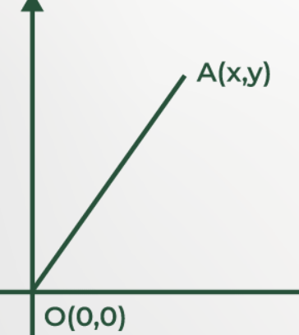
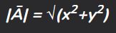
Vectors - Operations
Addition
Subtraction
Dot Product
Magnitude

Slide 6
Render Process

Slide 7
Render Process
Generating Objects
Generating camera with list of objects
Sending rays to scene
Finding if rays hits the objects
Colouring and reflections
Generating image

Slide 8
The Sphere

Slide 9
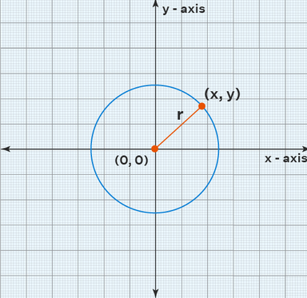
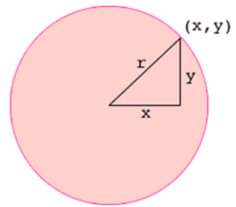
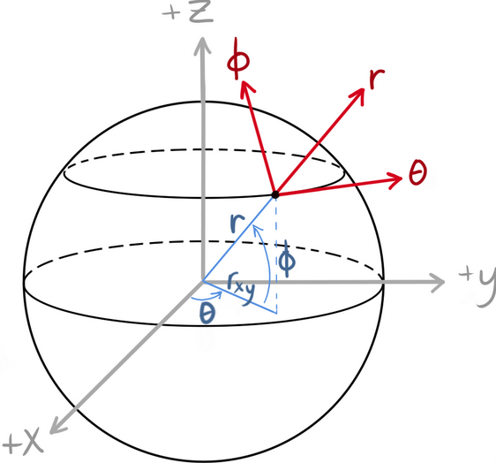
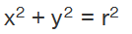
Sphere
x² + y² + z² = r².
Equation of circle

Slide 10
Ray

Slide 11
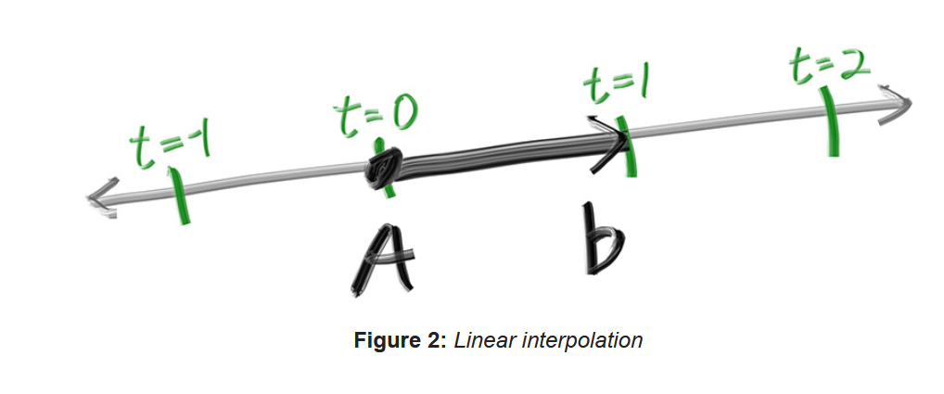
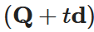
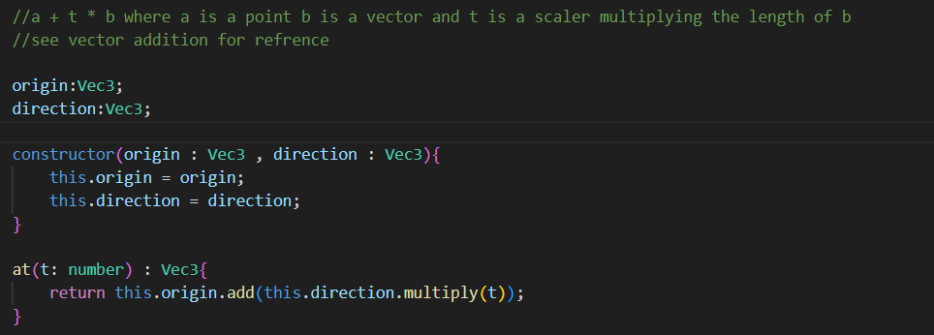
Ray
Direction
origin

Slide 12
The Camera

Slide 13
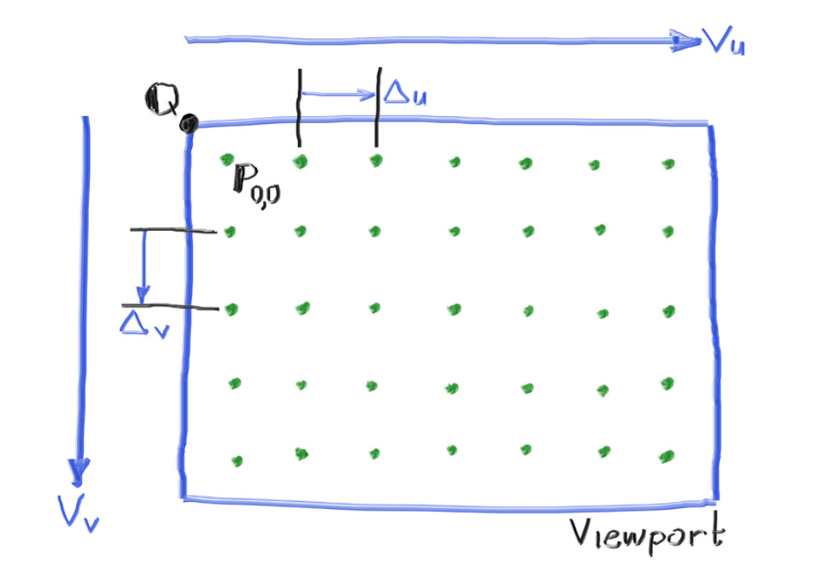
Camera
Top Left Corner = fl – (Vu / 2) + (Vv / 2)
Vu
Origin [0,0,0]
Focal Length (fl)
[0,0,(len)]
Vv
Del U = Vu / pixel width

Slide 14
Camera
Top Left Corner = fl – (Vu / 2) + (Vv / 2)
del Vu
Vu
del Vv
Del U = Vu / pixel width
Origin [0,0,0]
Focal Length (fl)
[0,0,(len)]
Vv

Slide 15
Camera
Top Left Corner = fl – (Vu / 2) + (Vv / 2)
Vu
del Vu
del Vv
Vv
Del U = Vu / pixel width
Origin [0,0,0]
Focal Length (fl)
[0,0,(len)]

Slide 16
Camera
Top Left Corner = fl – (Vu / 2) + (Vv / 2)
Vu
del Vu
del Vv
Vv
Del U = Vu / pixel width
Origin [0,0,0]
Focal Length (fl)
[0,0,(len)]

Slide 17
Camera
del Vv
Vu
del Vu
Vv
Del U = Vu / pixel width
Origin [0,0,0]
Focal Length (fl)
[0,0,(len)]

Slide 18
Camera
del Vv
Vu
del Vu
Vv
Del U = Vu / pixel width
Origin [0,0,0]
Focal Length (fl)
[0,0,(len)]

Slide 19
Ray Object Interaction

Slide 20
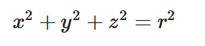
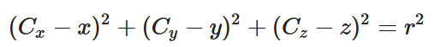
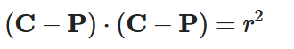
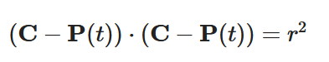
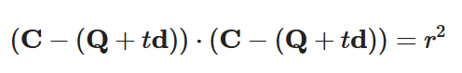
Ray Object interaction
Sphere At arbitrary location

Slide 21
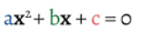
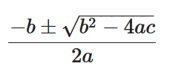
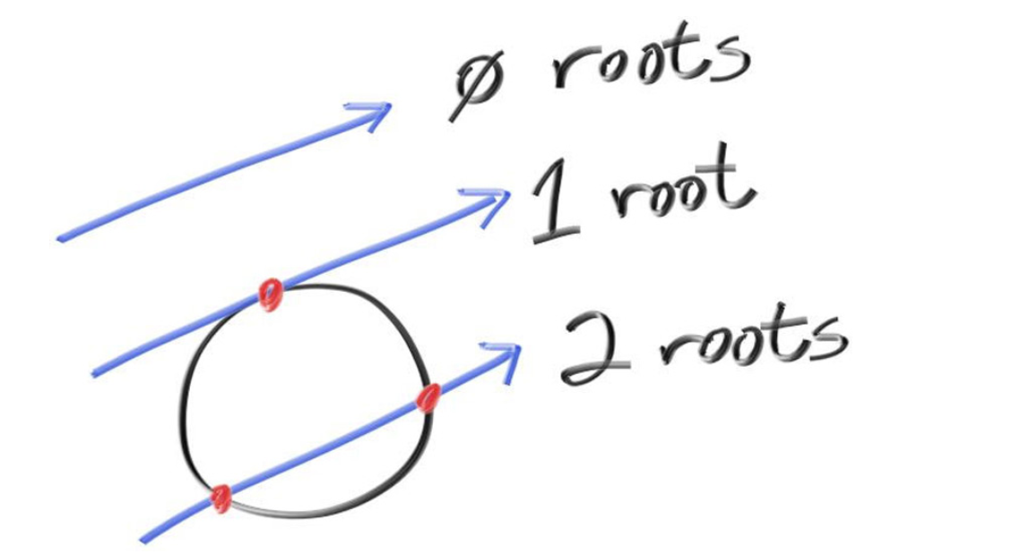
Ray object interaction

Slide 22
Surface normal

Slide 23
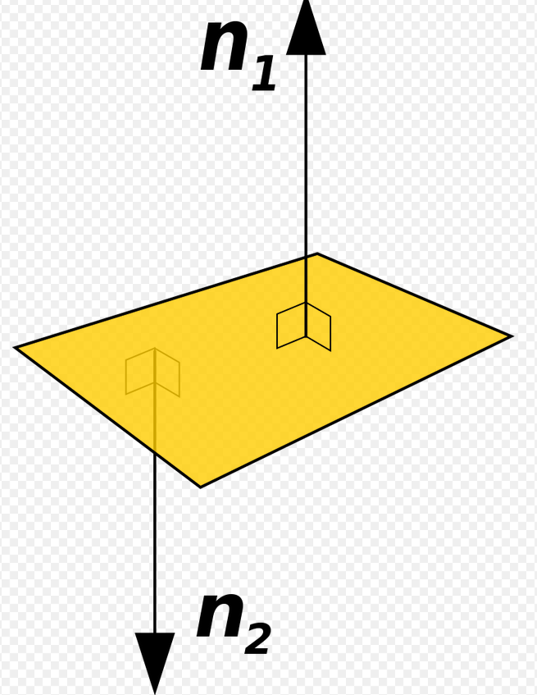
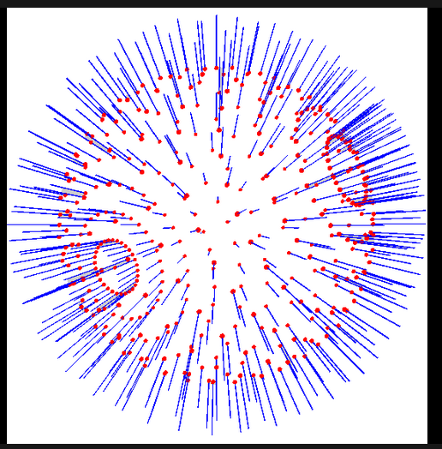
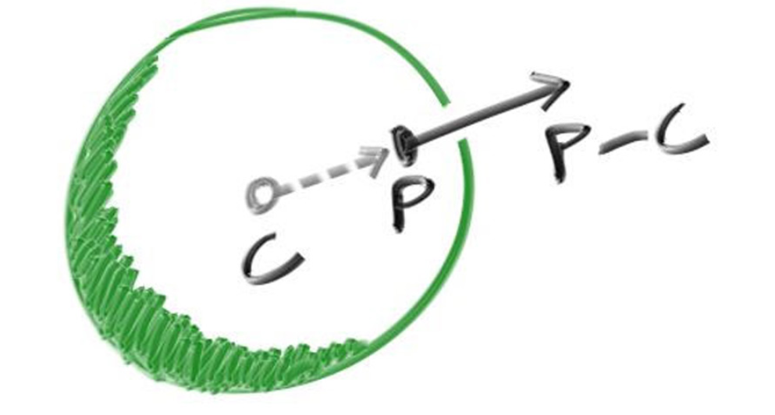
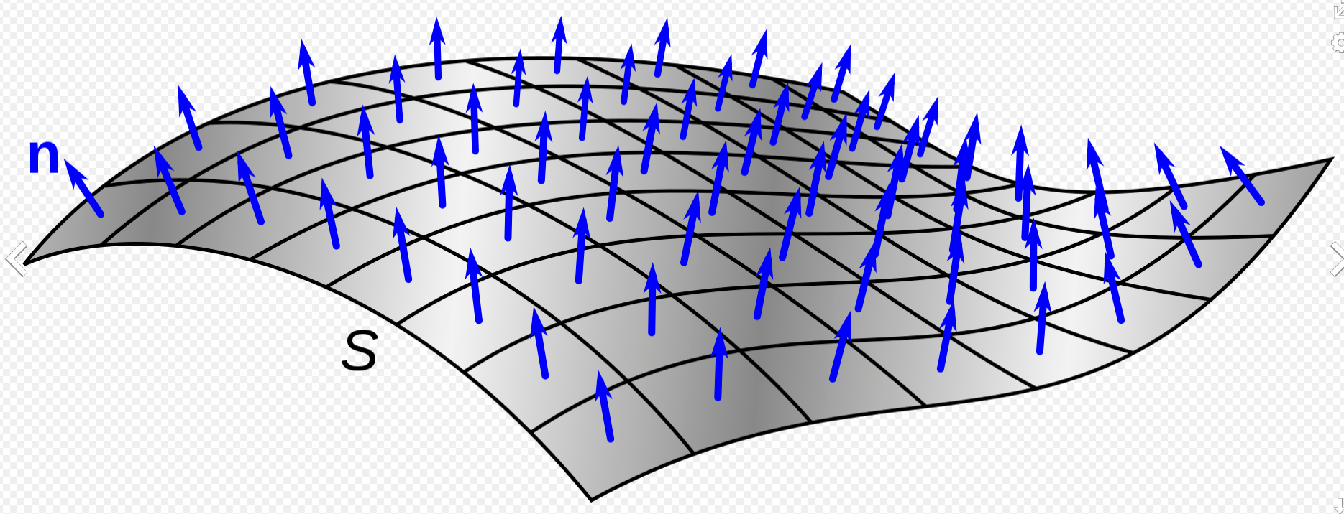
Surface normal

Slide 24
ANTI ALIASING

Slide 25
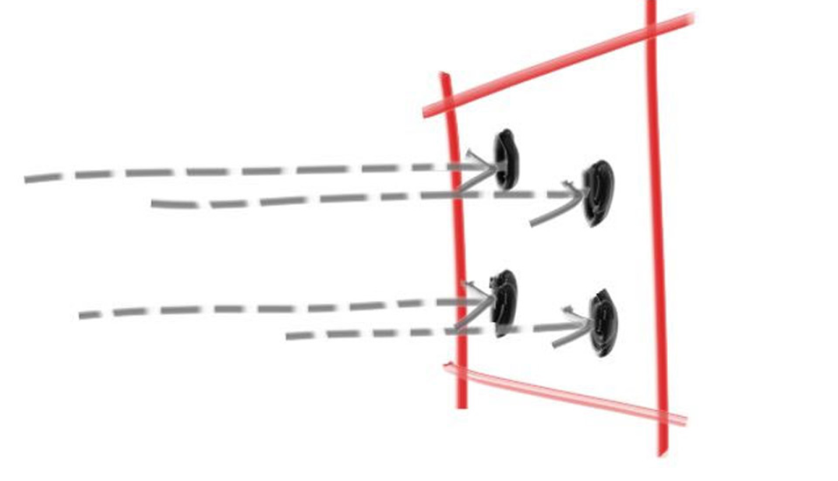

ANTI ALIASING

Slide 26
Materials

Slide 27
Diffuse - Lambertian

Slide 28
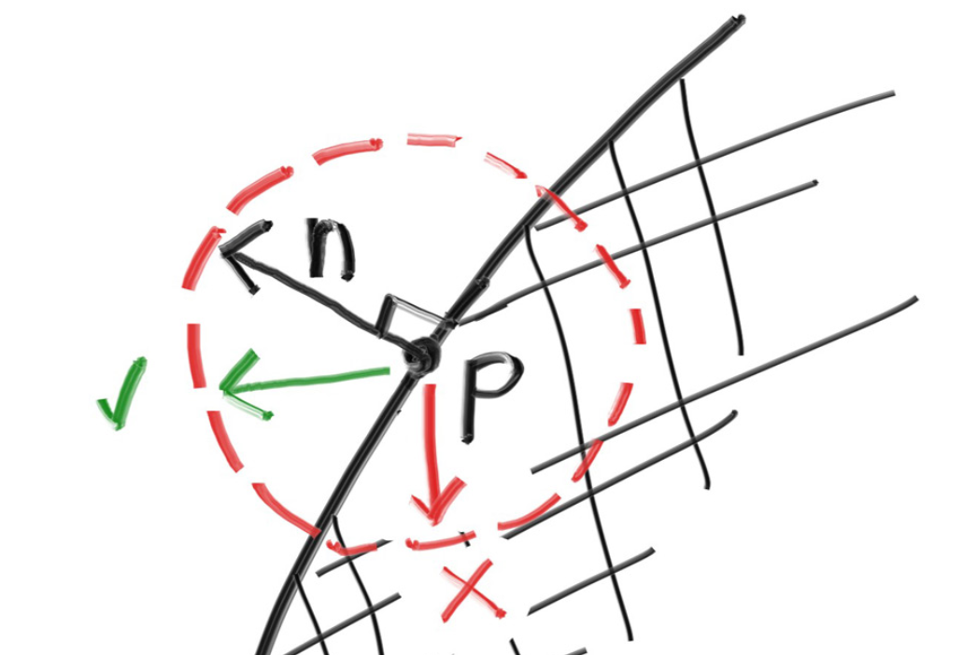
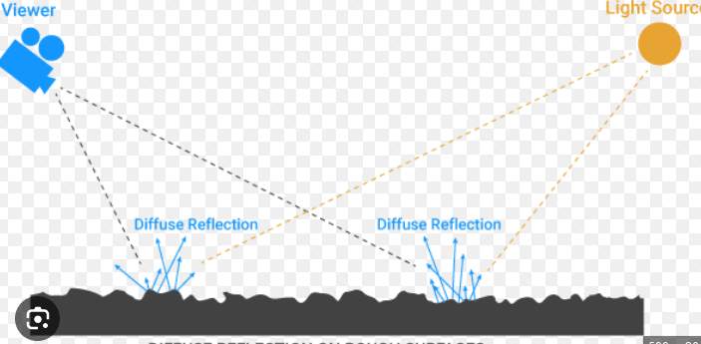
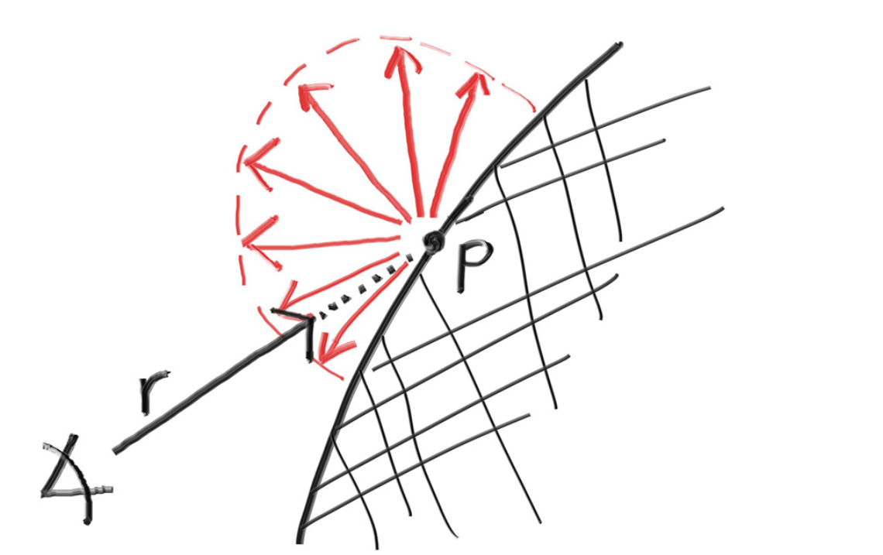
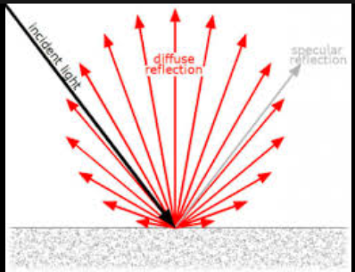
Diffuse

Slide 29
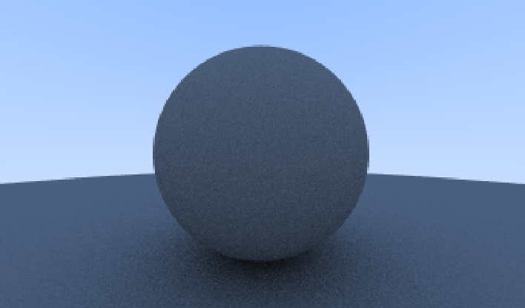
Diffuse

Slide 30
Metal

Slide 31
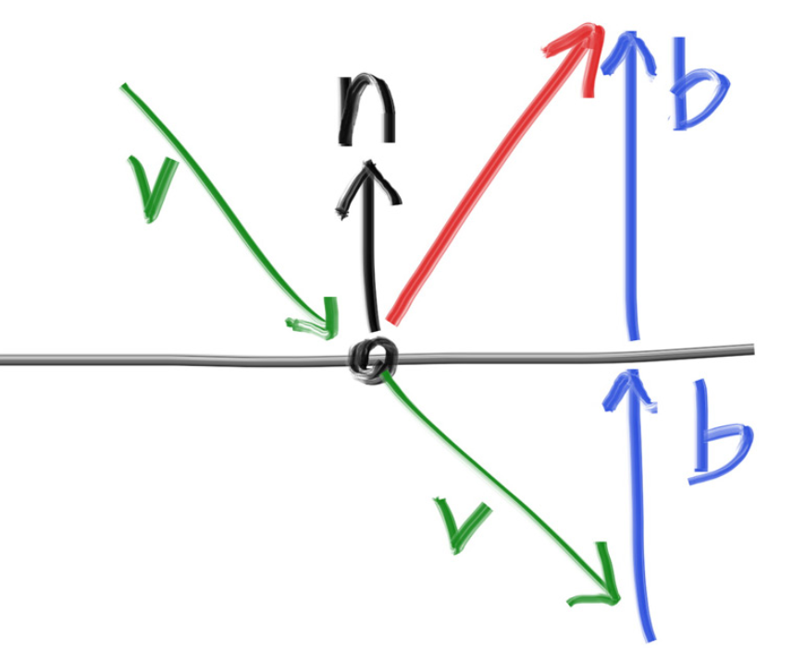
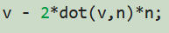
Metal

Slide 32
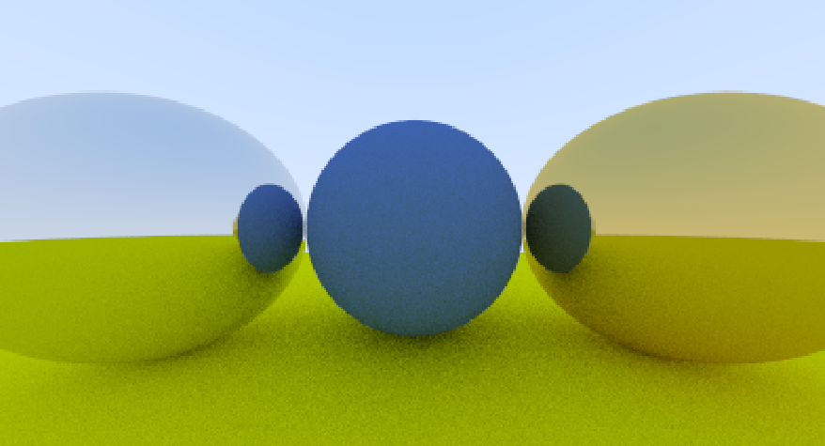
Metal

Slide 33
Dielectric’s

Slide 34
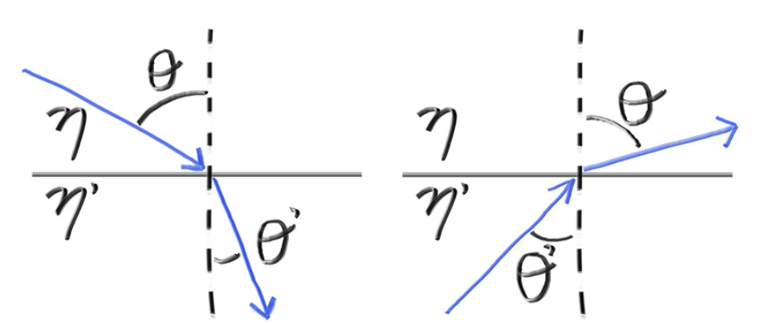
DiElectric

Slide 35
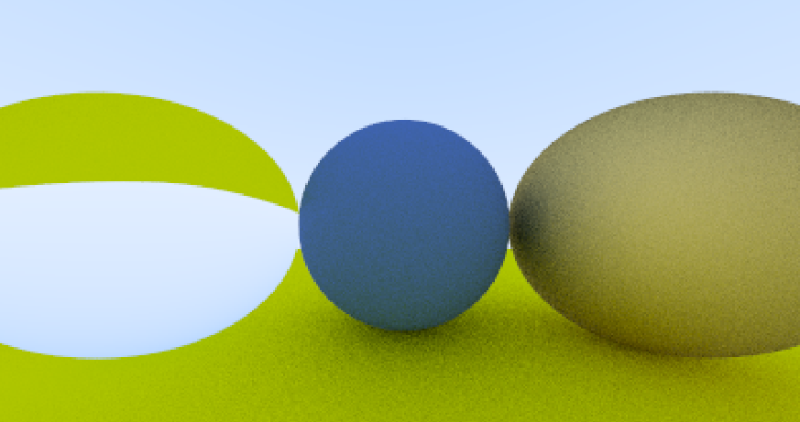
DiElectric

Slide 36
Adding EVERYTING UP

Slide 37
ADDING EVERYTING UP

Slide 38
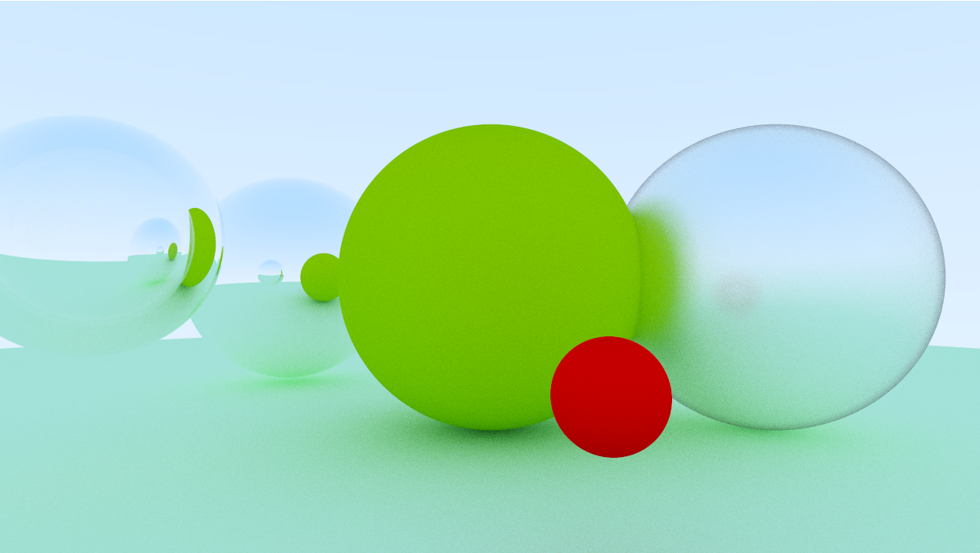
ADDING EVERYTING UP

Slide 39
Code
-code

Slide 40
Source
https://github.com/neerajsurjaye/SPRT

Slide 41
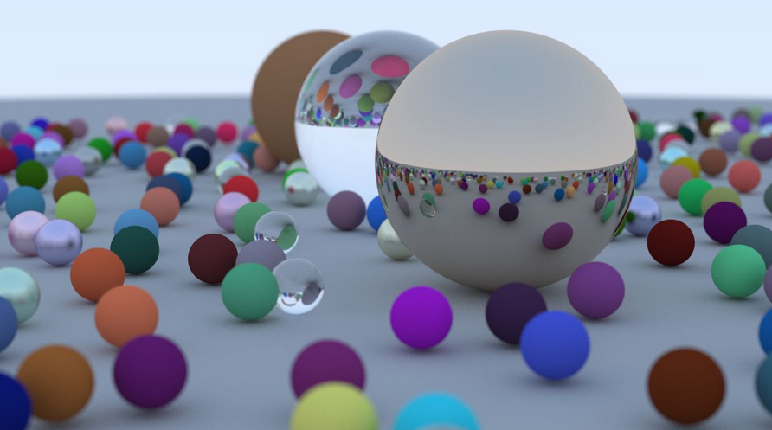
Going foreward
Realtime raytracing with gpu
Ui with electron js
More shapes or physics engine

